Slide 1
WEB WORKERS
JAVASCRIPT MULTITHREADING

Slide 2
Current scenario
JavaScript is a single-threaded
Previously multithreading behavior was achieved by setTimeout( ), setInterval( ), XMLHttpRequest( ) and event hadlers.
Any script which needs heavy-lifting, can be used with web workers
Do not lock up the browser

Slide 3
What are Web Workers
API for running scripts in the background
Independently of any user interface scripts
Browser runs web workers on different thread than UI thus provide multi-threaded behavior
Execute concurrently
Don’t block the UI
Allows us to use efficiently multicore CPU
Can be dedicated (single tab) or shared among tabs/windows

Slide 4
…
Might be partially replaced by Window.setTimeout() function
If we call function by setTimeout, the execution of script and UI are suspended
To create Worker, put JavaScript in separate file and create new Worker instance:
var worker = new Worker(‘extra_work.js’);
communicate in worker happens using “Message” event

Slide 5
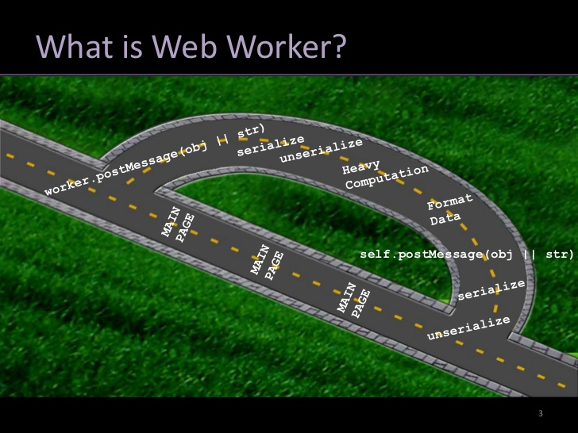

Slide 6
Messages are send to all threads in our application:
MAIN.JS:
var worker = new Worker(‘extra_work.js');
worker.onmessage = function (event) { alert(event.data); };
extra_work.js:
//do some work; when done post message.
// some_data could be string, array, object etc.
postMessage(some_data);

Slide 7
Limitations:
No Access:
DOM
Window
Document
Parent
Main App Memory/Object
You Do Have Access To
XHR
Navigator , Location
App cache
Import script

Slide 8
Can be used for :-
Background number crunching
Background notification from server to local database
Background updating from server
Search queries
Prefetching data for later use
Process large arrays or JSON responses

Slide 9
Browser Support :-
Chrome 4.0+
Firefox 3.5+
Safari 4.0+
Opera 11.5+
iOS Safari 5.1+
IE 10+

